Slide 1
Primary Longman Elect
3B Chapter 1
Prepositions

Slide 2
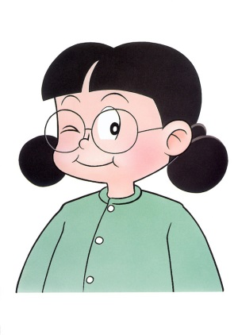
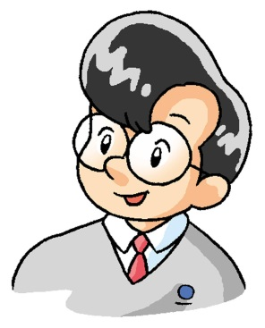
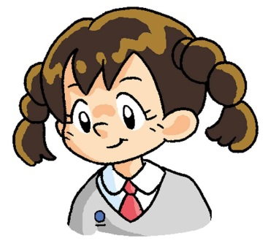
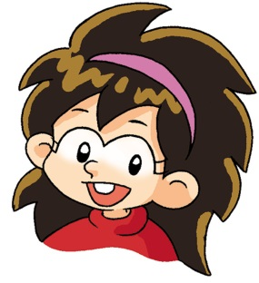
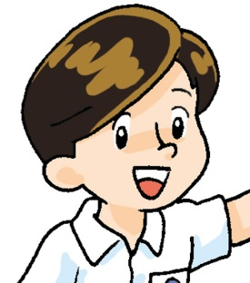
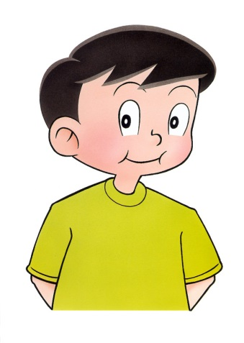
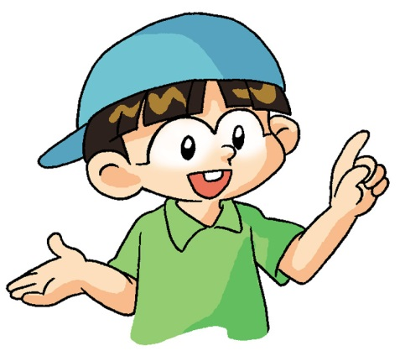
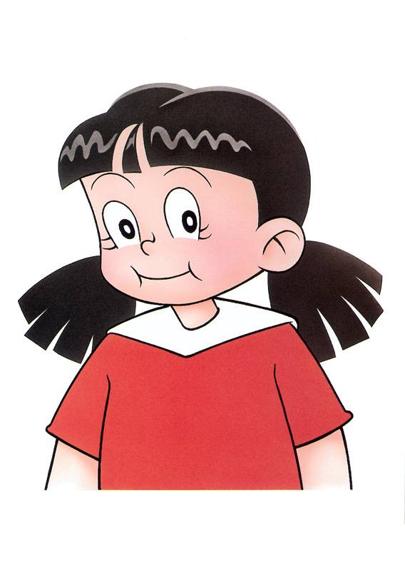
Prepositions
Meet Sam and his friends.
Sam

Slide 3
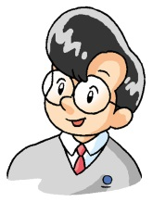
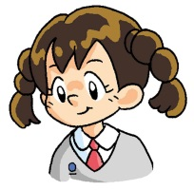
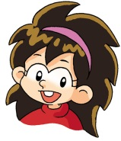
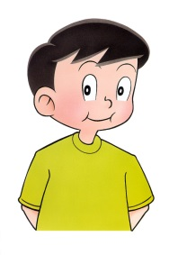
Prepositions
Sam sits between Annie and Ken.
Annie
Sam
Ken

Slide 4
Prepositions
Sam sits behind Katy.
Sam
Katy
You can see the person when you sit behind him / her.

Slide 5
Prepositions
Katy sits in front of Sam.
✗
Sam
Katy
You cannot see the person when you sit in front of him / her.

Slide 6
Prepositions
Ken sits next to Sam. / Sam sits next to Ken.
Sam’s right
Sam’s left
Sam
Ken
Ken sits on my left.
on my left = next to me

Slide 7
Prepositions
Sam sits next to Annie. / Annie sits next to Sam.
Sam’s right
Sam’s left
Annie
Sam
Annie sits on my right.
on my right = next to me

Slide 8
Prepositions
We use between / in front of / behind / next to / on my left / right to talk about positions.
Be careful with on my left / right.
Facing front
left
right
This is the girl’s left hand.
This is the girl’s right hand.

Slide 9
Key structure
between
Dick and Fiona.
in front of
Barry sits
behind
Ron / me.
next to
on my left / right.

Slide 10
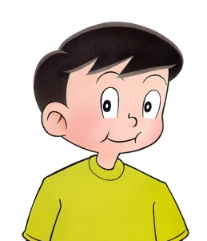
Practice
Fill in the blank with the correct preposition.
Sue
David
May
Annie
Sam
Ken
Tony
Katy
Ben
Katy sits _________ Ben.
next to

Slide 11
Practice
Fill in the blank with the correct preposition.
Sue
David
May
Annie
Sam
Ken
Tony
Katy
Ben
David sits _________ Sue and May.
between

Slide 12
Practice
Fill in the blank with the correct preposition.
Sue
David
May
Annie
Sam
Ken
Tony
Katy
Ben
my right
Katy sits on ________ .

Slide 13
Practice
Fill in the blank with the correct preposition.
Sue
David
May
Annie
Sam
Ken
Tony
Katy
Ben
Tony sits ___________ Annie.
in front of

Slide 14
Practice
Fill in the blank with the correct preposition.
Sue
David
May
Annie
Sam
Ken
Tony
Katy
Ben
Sam sits on ________ .
my left

Slide 15
Practice
Fill in the blank with the correct preposition.
Sue
David
May
Annie
Sam
Ken
Tony
Katy
Ben
May sits ________ Ken.
behind

Slide 16
The End

